Slide 1
This 2’ 15” slide-show has been assembled by the West Coast Climate Action Network to respect and honour the grief of Indigenous Peoples
at the discovery of the bodies of
215 children at the Kamloops Indian Residential School,
and the knowledge that thousands more Indigenous children
died or were killed in these schools, all across Canada.
June 2nd 2021

Slide 2
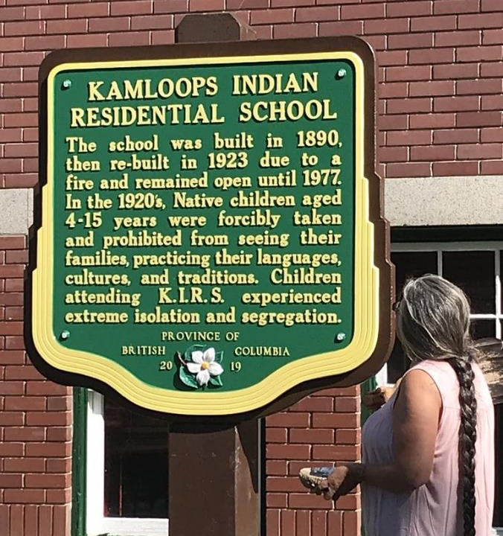

Slide 3
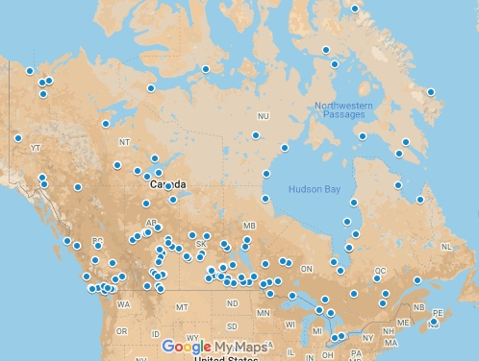
The Residential Schools of Canada

Slide 4
“When the school is on the reserve, the child lives with its parents, who are savages, and though he may learn to read and write, his habits and training mode of thought are Indian. He is simply a savage who can read and write.
It has been strongly impressed upon myself, as head of the Department, that Indian children should be withdrawn as much as possible from the parental influence, and the only way to do that would be to put them in central training industrial schools where they will acquire the habits and modes of thought of white men.”
— Prime Minister John A. Macdonald, 1879

Slide 5
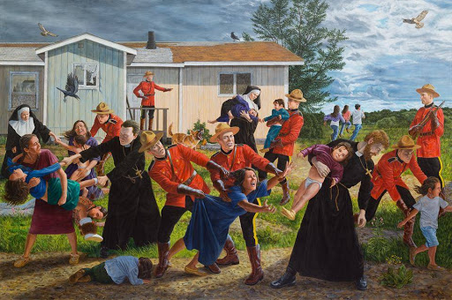
Shame and Prejudice: A Story of Resilience, by Kent Monkman
https://agnes.queensu.ca/site/uploads/2017/07/Monkman_Brochure.pdf

Slide 6
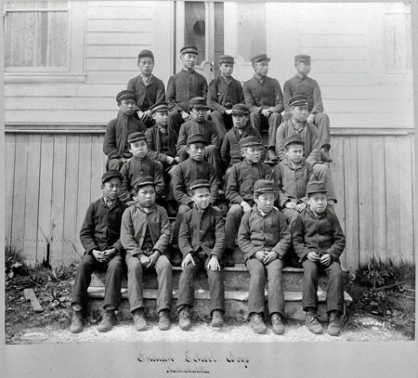

Slide 7
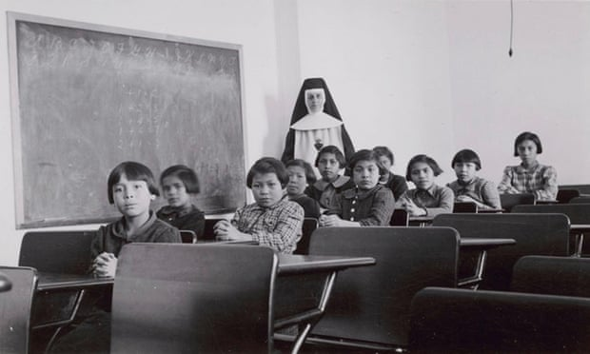

Slide 8
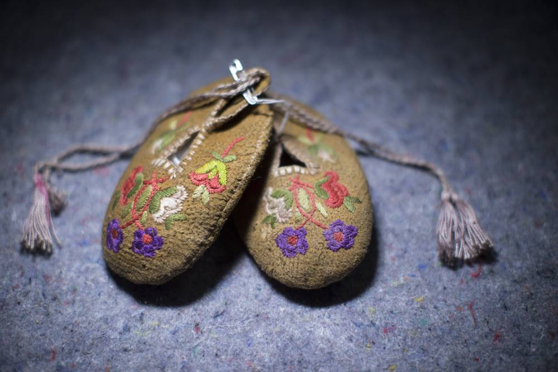

Slide 9
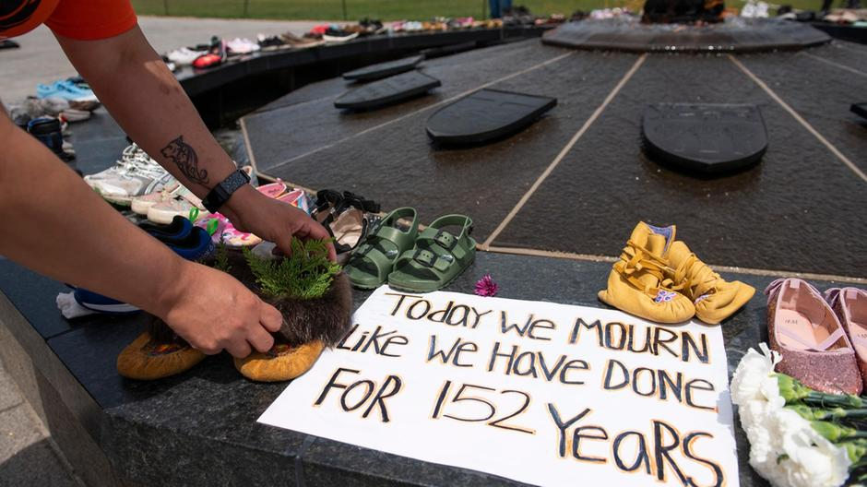

Slide 10
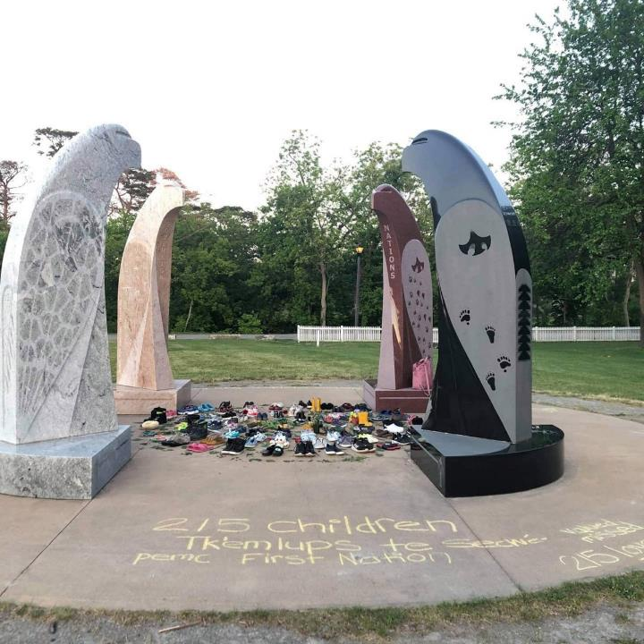

Slide 11
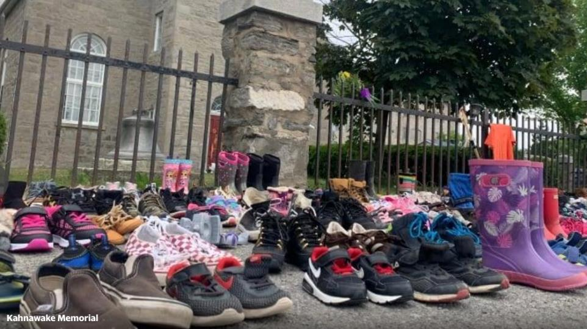

Slide 12
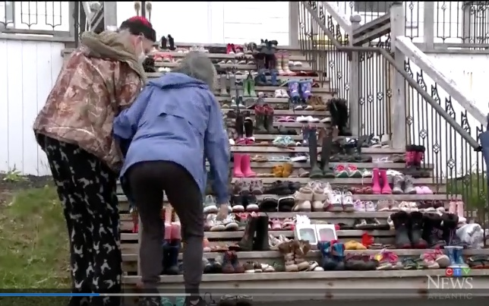

Slide 13
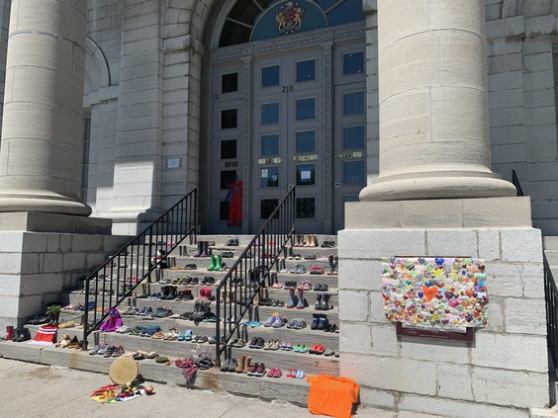

Slide 14
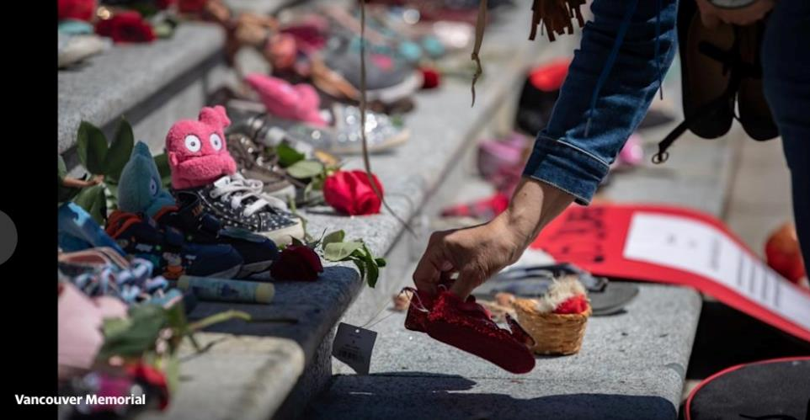

Slide 15
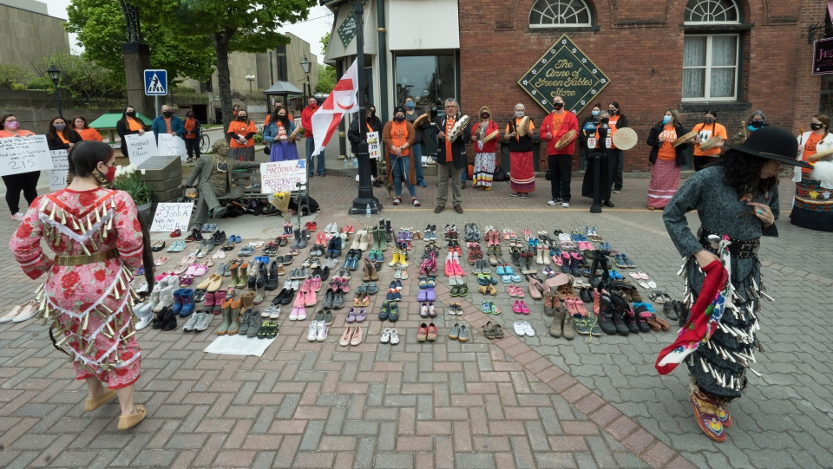

Slide 16
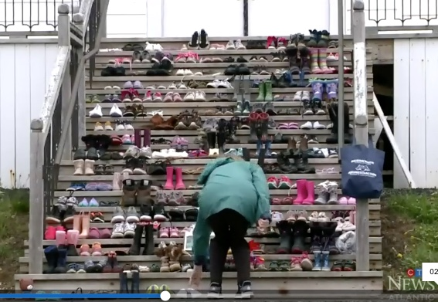

Slide 17
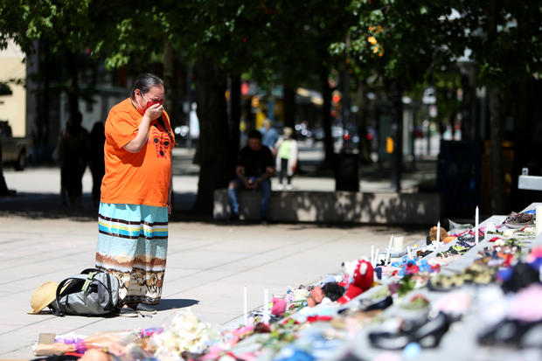

Slide 18
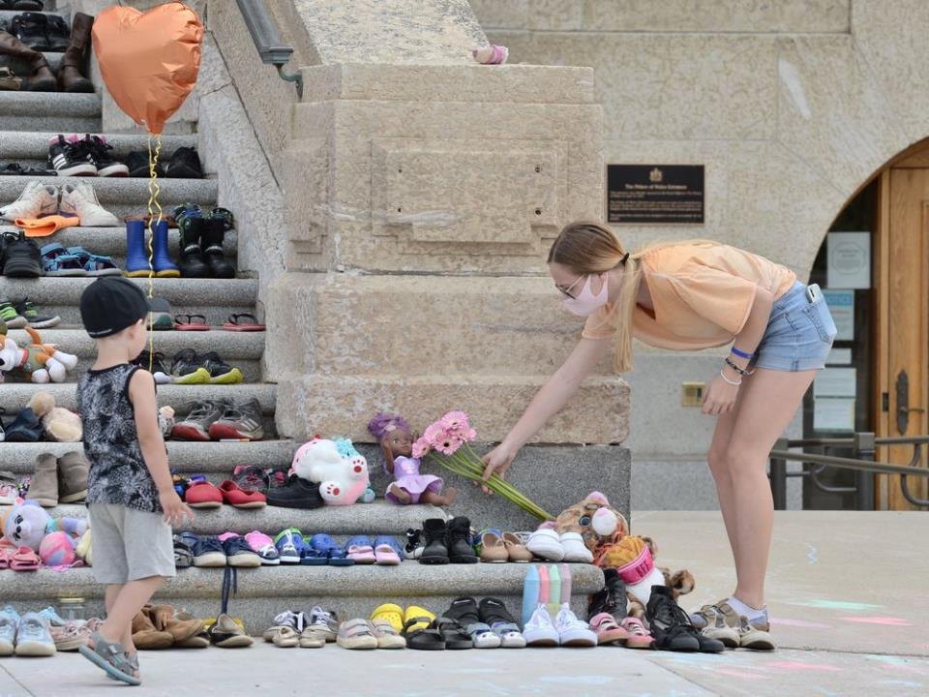

Slide 19
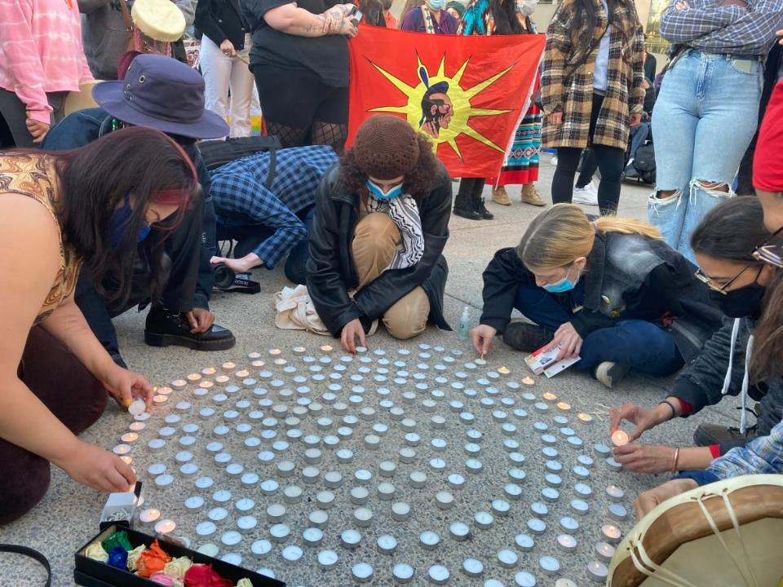

Slide 20
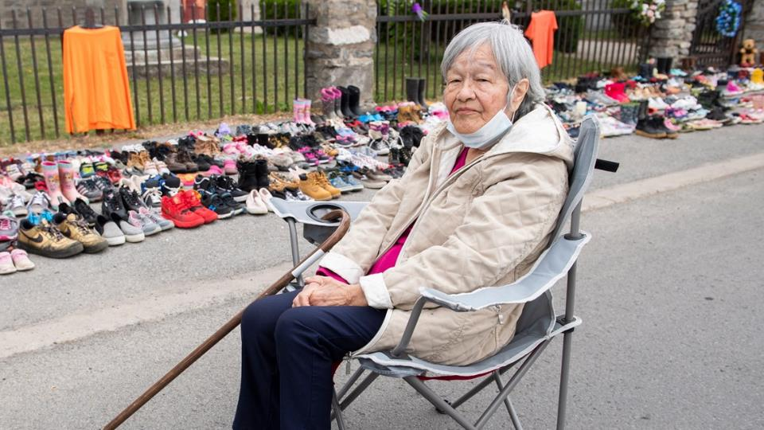

Slide 21
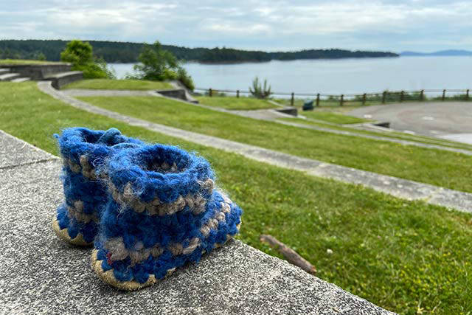

Slide 22
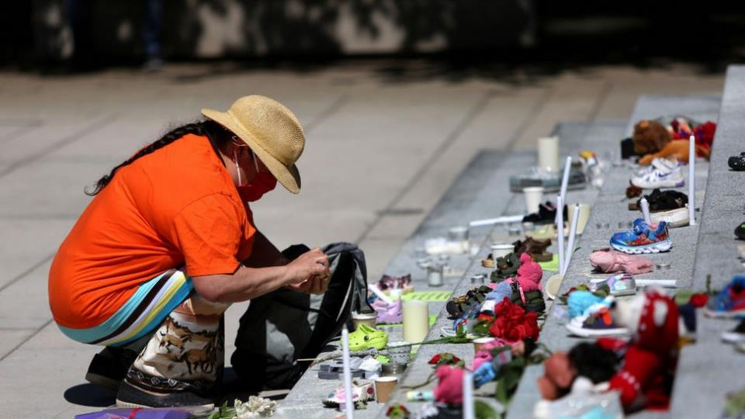

Slide 23
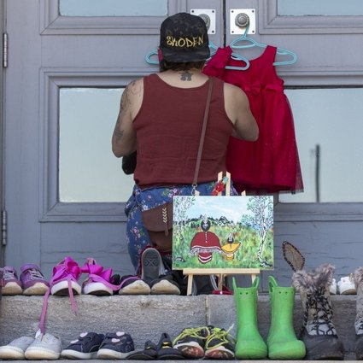

Slide 24
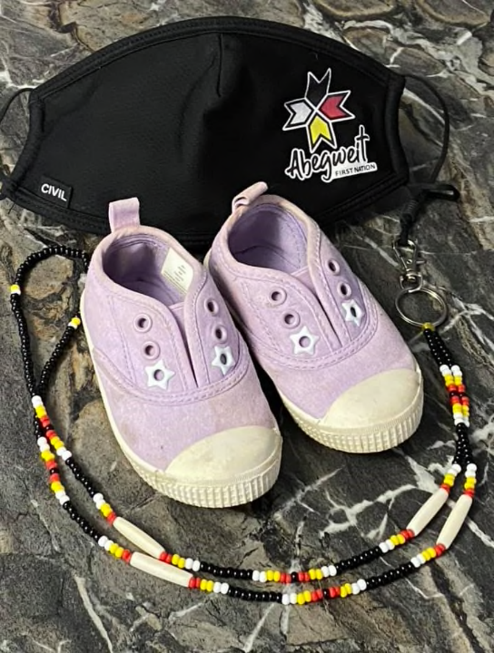

Slide 25
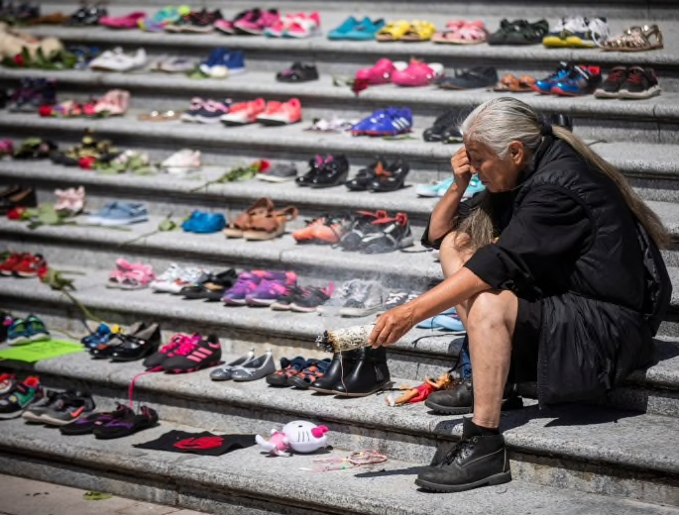

Slide 26
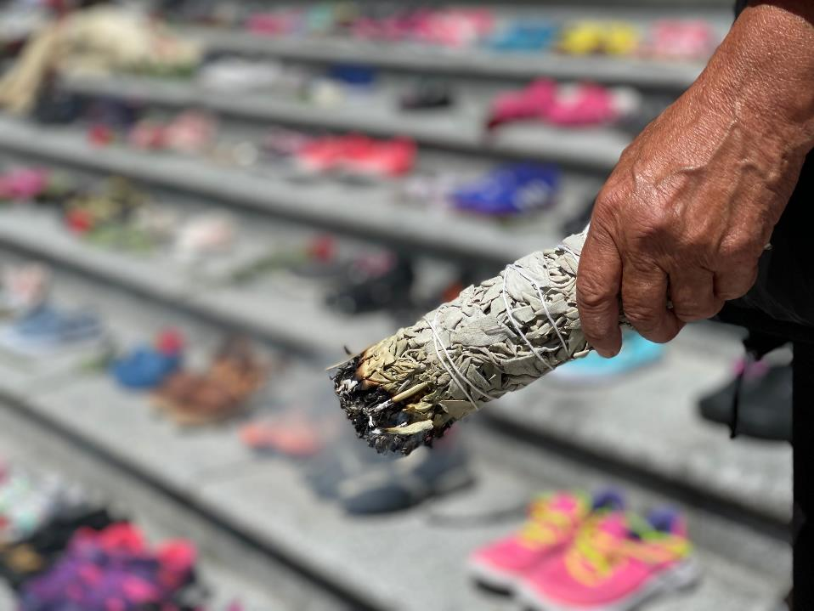

Slide 27
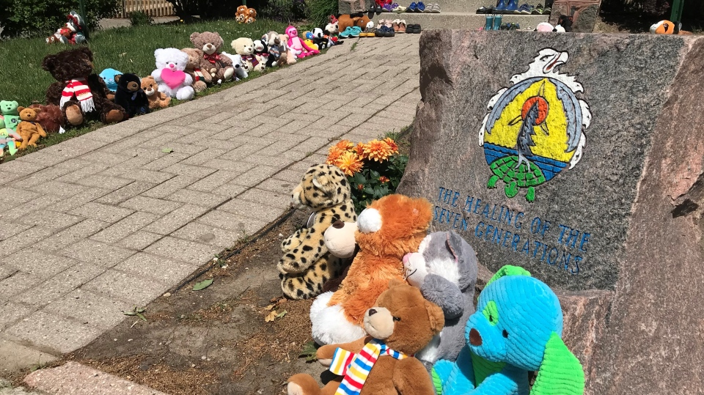

Slide 28
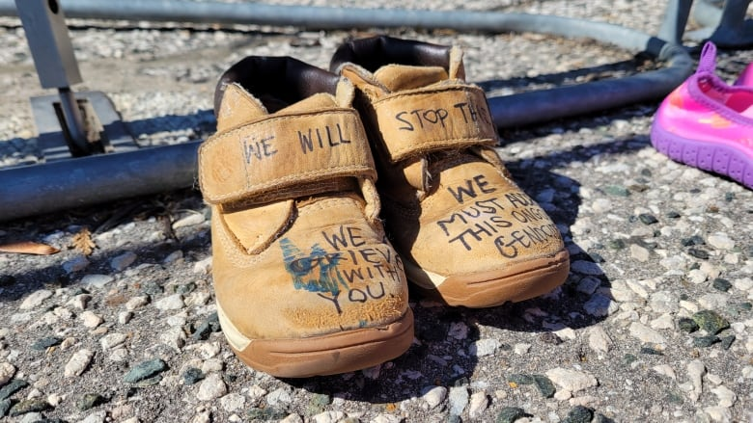

Slide 29
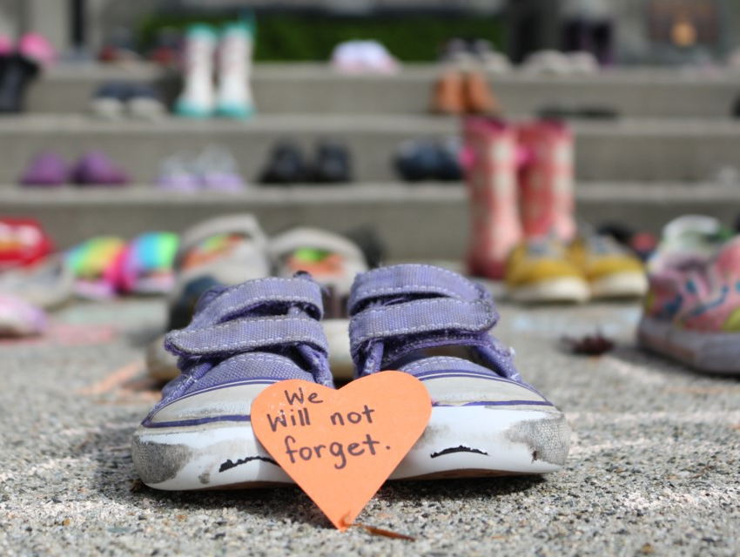

Slide 31
UBC Healing and Wellness Advice
www.tinyurl.com/UBCHealing

